Slide 1
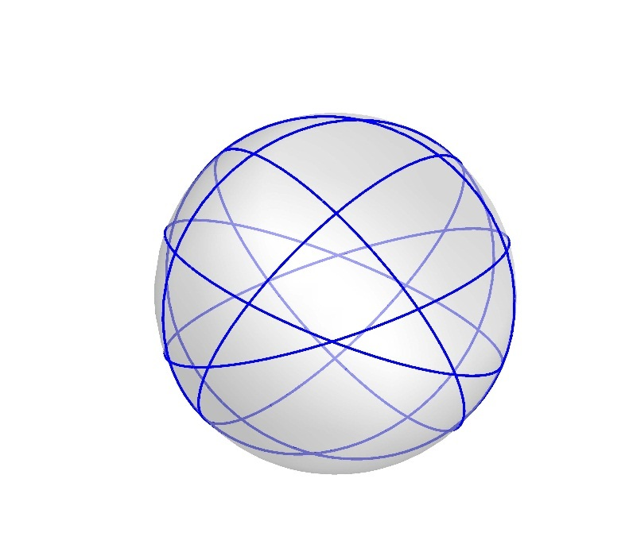
Great Circles Problem
Kha Man
05/24/2015

Slide 2
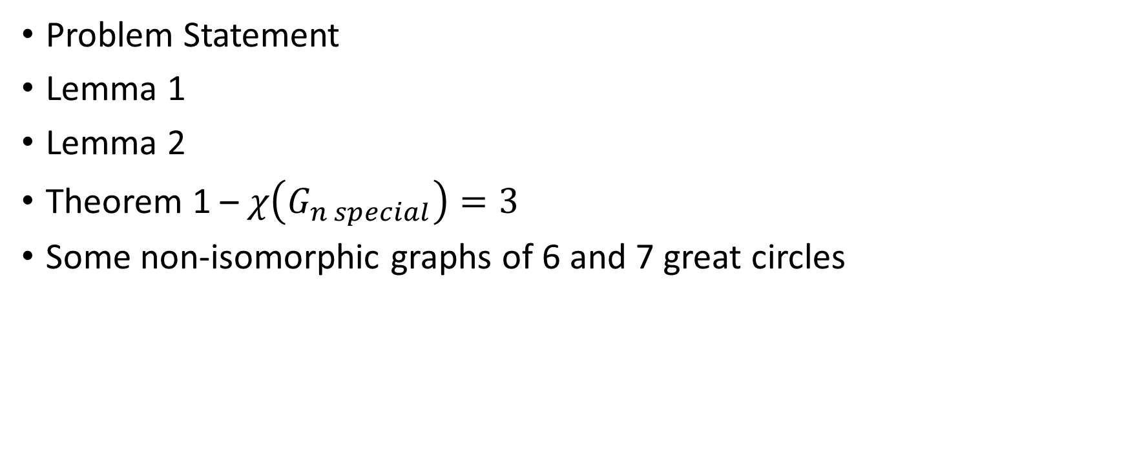
Outline
Problem Statement
Lemma 1
Lemma 2
Theorem 1 – $χ\left(G_{n special}\right)=3$
Some non-isomorphic graphs of 6 and 7 great circles

Slide 3
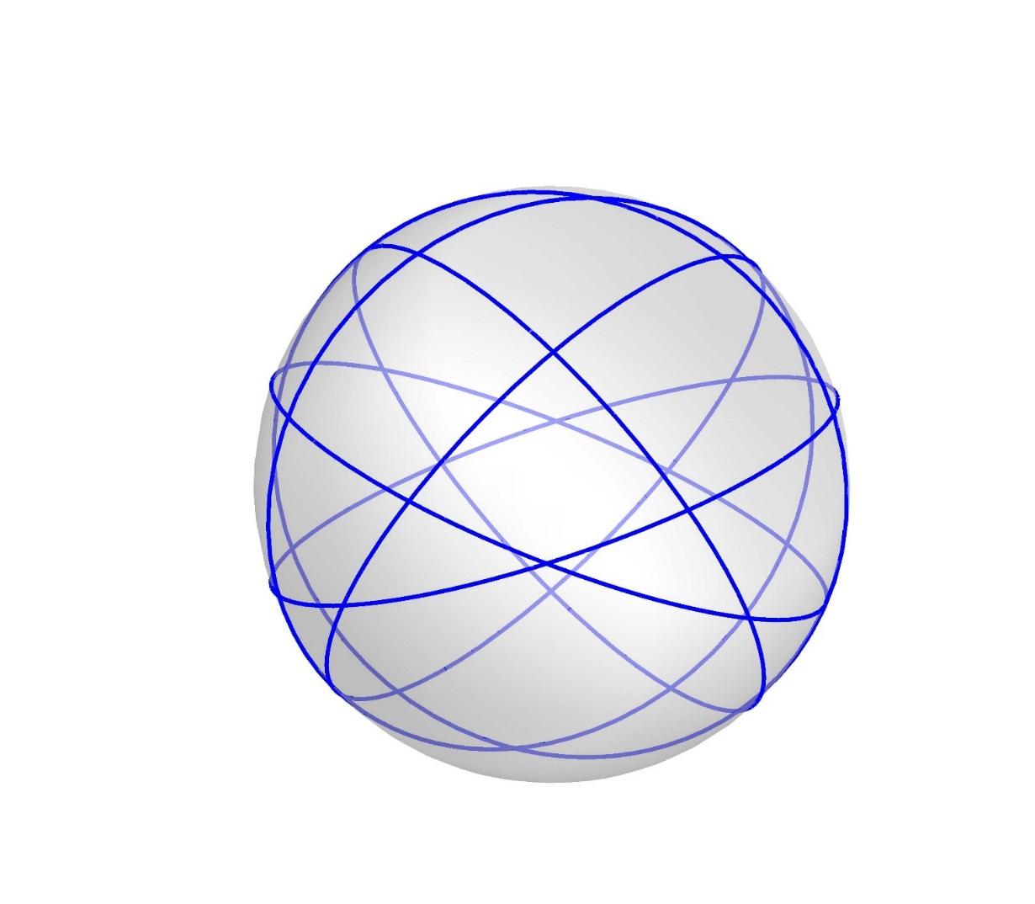
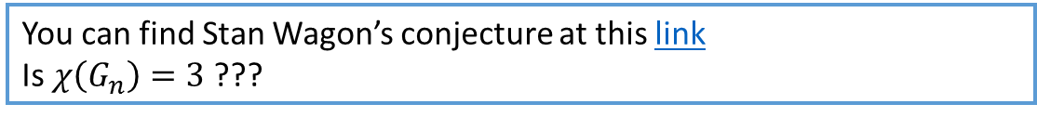
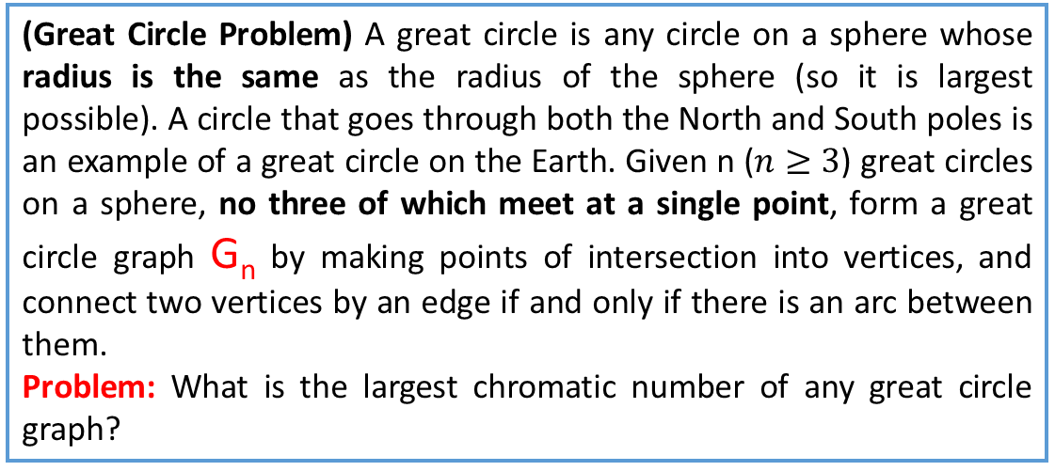
Problem Statement
(Great Circle Problem) A great circle is any circle on a sphere whose radius is the same as the radius of the sphere (so it is largest possible). A circle that goes through both the North and South poles is an example of a great circle on the Earth. Given n ($n≥3$) great circles on a sphere, no three of which meet at a single point, form a great circle graph G_{n} by making points of intersection into vertices, and connect two vertices by an edge if and only if there is an arc between them.
Problem: What is the largest chromatic number of any great circle graph?
You can find Stan Wagon’s conjecture at this link
Is $χ\left(G_{n}\right)=3$ ???

Slide 4
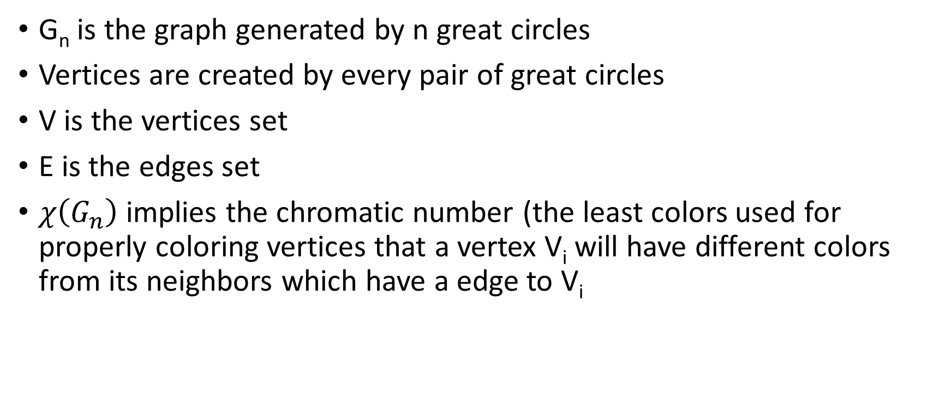
Model the problem
G_{n} is the graph generated by n great circles
Vertices are created by every pair of great circles
V is the vertices set
E is the edges set
$χ\left(G_{n}\right)$ implies the chromatic number (the least colors used for properly coloring vertices that a vertex V_{i} will have different colors from its neighbors which have a edge to V_{i}

Slide 5
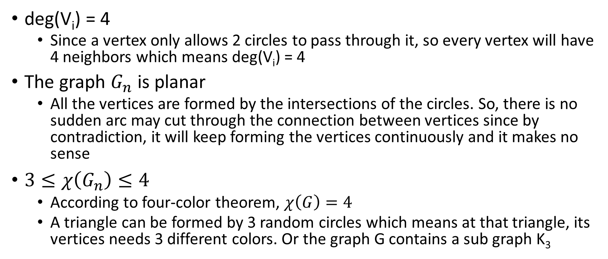
Some properties
deg(V_{i}) = 4
Since a vertex only allows 2 circles to pass through it, so every vertex will have 4 neighbors which means deg(V_{i}) = 4
The graph $G_{n}$ is planar
All the vertices are formed by the intersections of the circles. So, there is no sudden arc may cut through the connection between vertices since by contradiction, it will keep forming the vertices continuously and it makes no sense
$3≤χ\left(G_{n}\right)≤4$
According to four-color theorem, $χ\left(G\right)=4$
A triangle can be formed by 3 random circles which means at that triangle, its vertices needs 3 different colors. Or the graph G contains a sub graph K₃

Slide 6
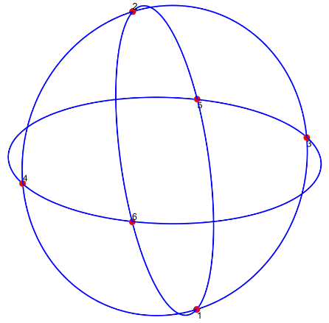
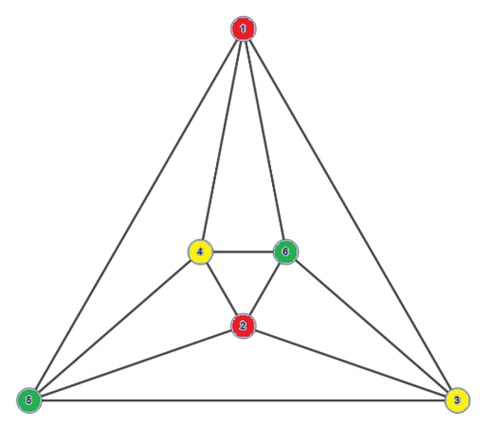
A warm start with some base cases
Generate 3 great circles
and get the intersections
Create a 2D intuitive look with the same vertices
Use least colors for vertices (3)
There is only 1 non-isomorphic graph for G₃ (This can be verified manually)

Slide 7
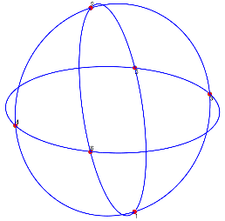
Get G₄ from G₃
+ 1 great circle = ???
There are 3 cases happen when the 4th great circle is added:
It cuts arc(1,5), arc(1,3), arc(2,6), arc(2,4), arc(3,6) and arc(4,5)
It cuts arc(1,3), arc(3,5), arc(2,4), arc(4,6), arc(1,6) and arc(2,5)
It cuts arc(1,5), arc(3,5), arc(2,6), arc(4,6), arc(2,6) and arc(1,5)
The outcome of 3 cases is the same as the figure on the right
➔ 1 non-isomorphic graph for G₄
G₄

Slide 8
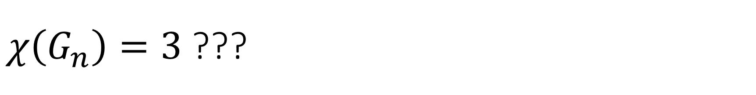
$χ\left(G_{n}\right)=3$ ???
Probably
G_{n} is basically 4-regular planar graph without no intuitive and special properties
We may create great circles more specifically to somehow reduce the randomness

Slide 9
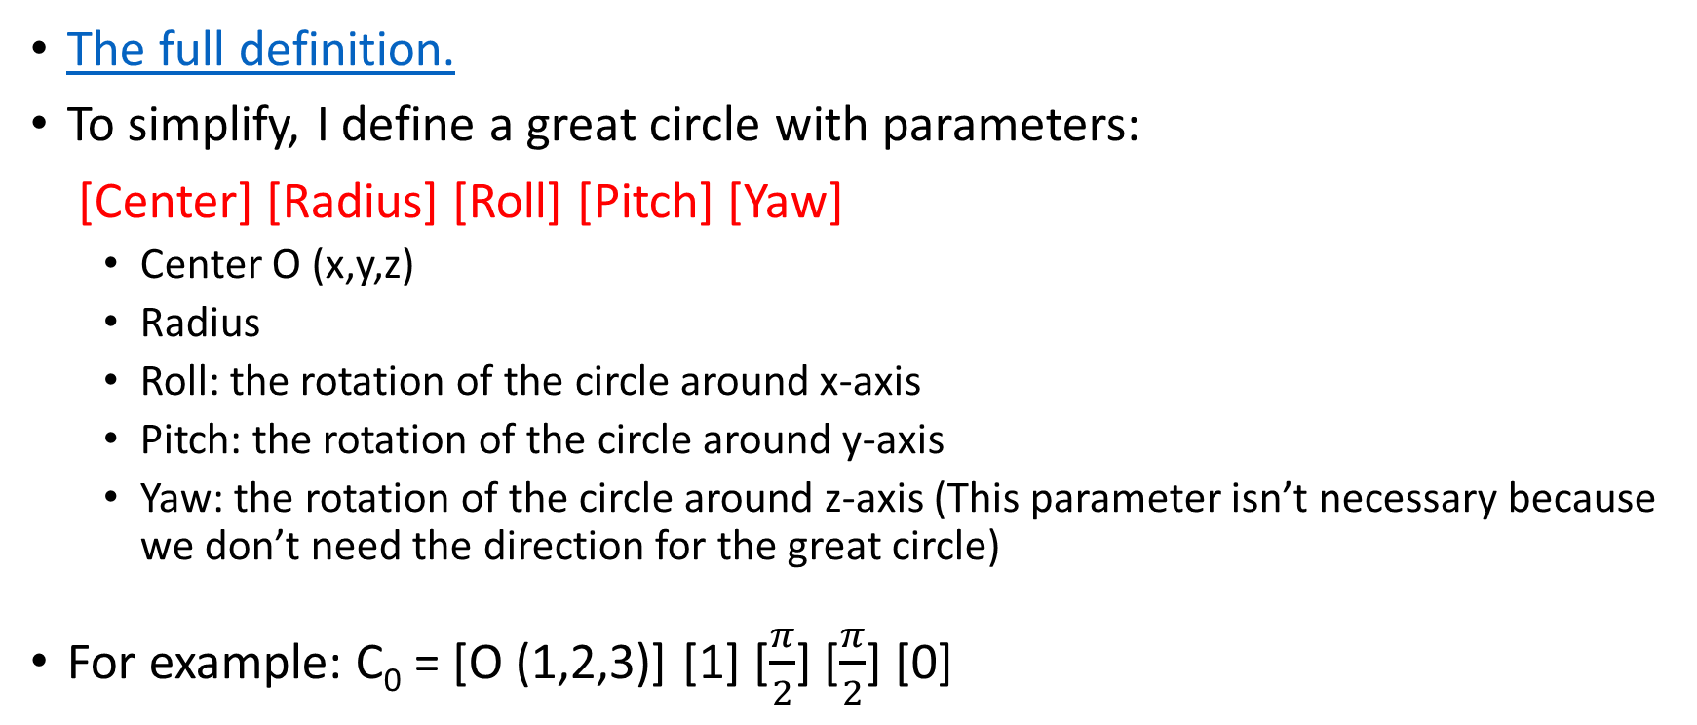
The definition of a great circle
The full definition.
To simplify, I define a great circle with parameters:
[Center] [Radius] [Roll] [Pitch] [Yaw]
Center O (x,y,z)
Radius
Roll: the rotation of the circle around x-axis
Pitch: the rotation of the circle around y-axis
Yaw: the rotation of the circle around z-axis (This parameter isn’t necessary because we don’t need the direction for the great circle)
For example: C₀ = [O (1,2,3)] [1] [$\frac{π}{2}$] [$\frac{π}{2}$] [0]

Slide 10
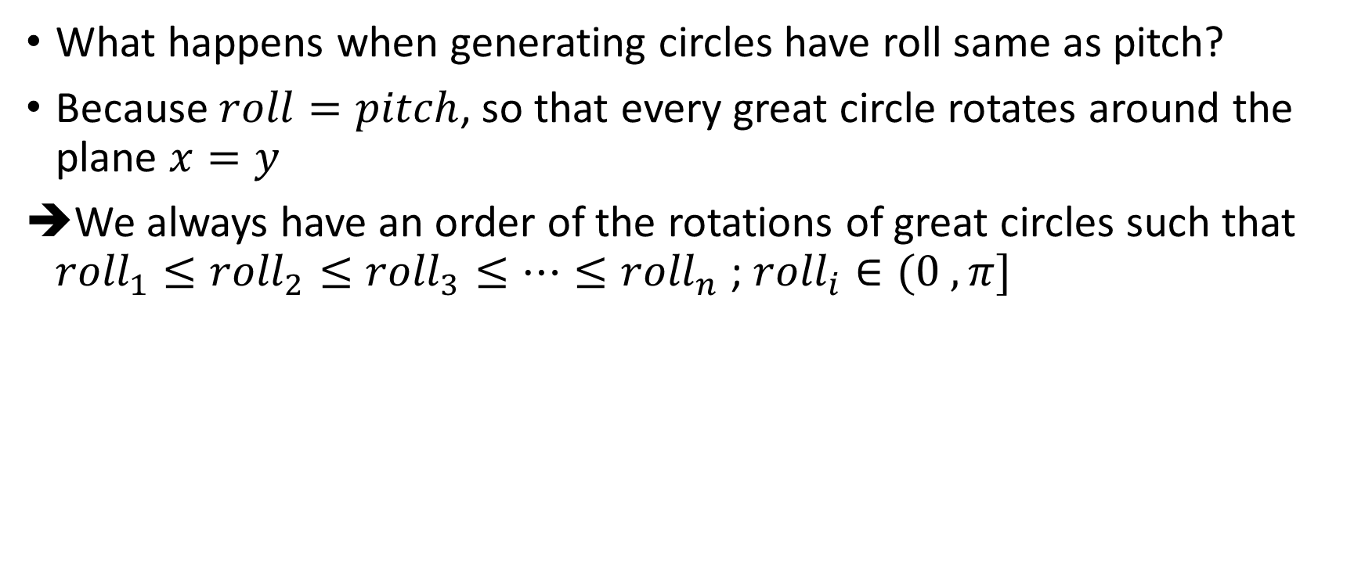
An arrangement
What happens when generating circles have roll same as pitch?
Because $roll=pitch$, so that every great circle rotates around the plane $x=y$
We always have an order of the rotations of great circles such that ${roll}_{1}≤{roll}_{2}≤{roll}_{3}≤…≤{roll}_{n}$ ; ${roll}_{i}∈(0 , π]$

Slide 11
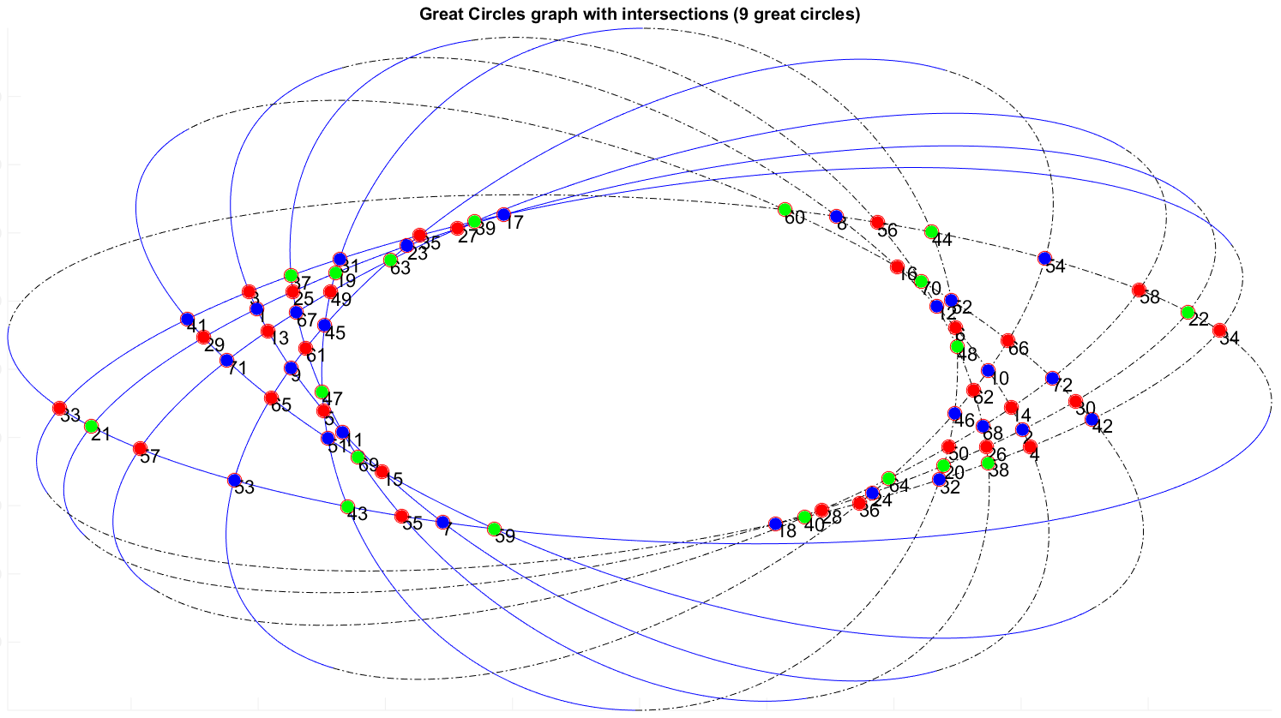
Redraw the graph in 2D
We can redraw the new arrangement by making some ellipses which have a half for “top” and another half for “bottom”
Every pair of “ellipses” with the same “top” or “bottom” will intersect
Since roll = pitch, “ellipses” rotate around an imaginary lines so that we always have the order

Slide 12
The special graph
So I come with the definition for the new arrangement
Definition:
G_{n} is special if it has the same shape as one consisting of roll=pitch great circles
Annotation: G_{n special}

Slide 13
Some lemmas and theorems

Slide 14
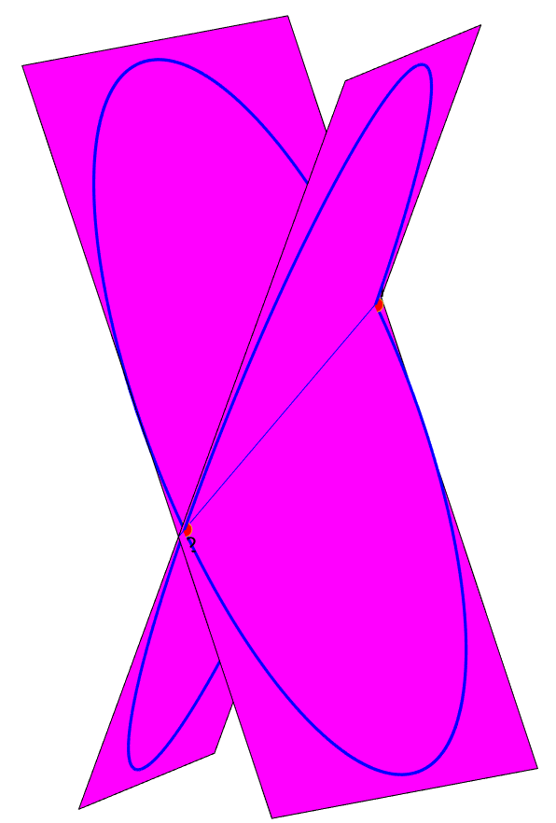
A basic properties of G_{n}
The center of all circles O is the point symmetry of vertices on both sides of the line connected 2 middle points
Proof:
2 circles in 3D can be considered as 2 planes.
The intersection of 2 planes is a line
Therefore, all the intersections created by pairs of circles and O are on the line.

Slide 15
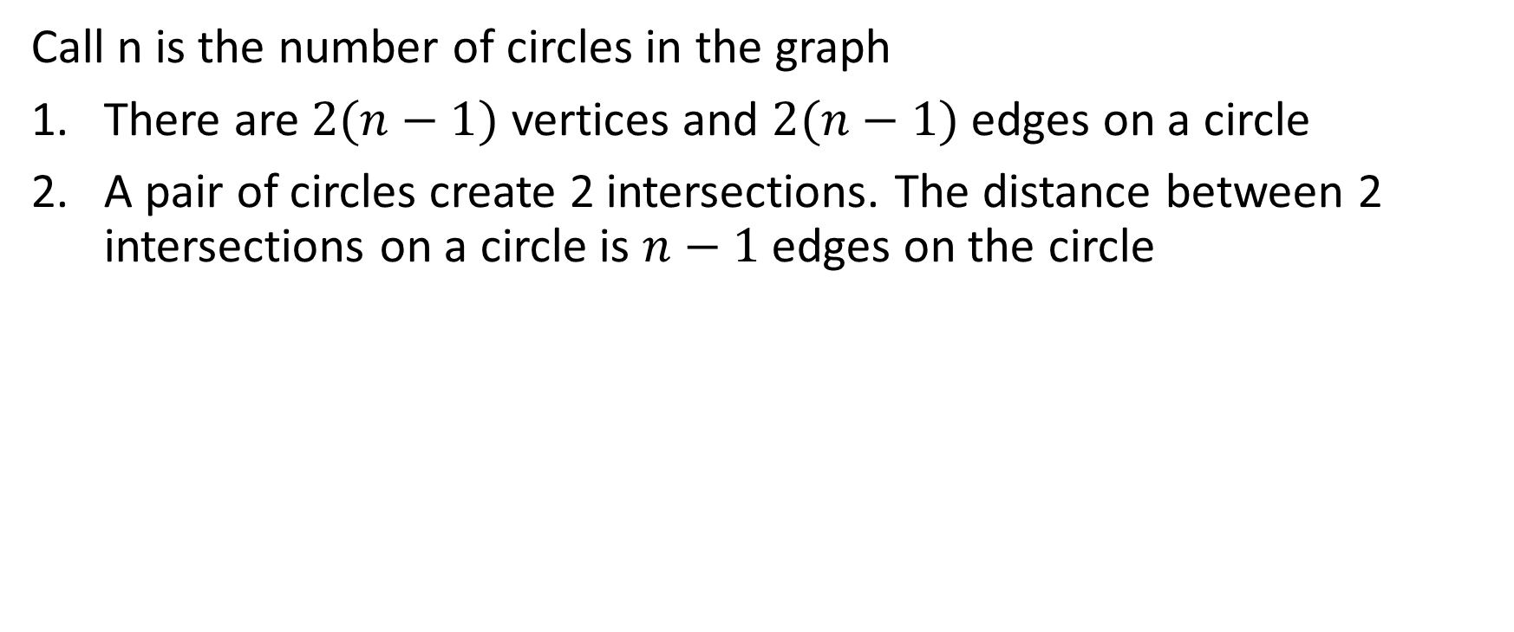
Lemma 1
Call n is the number of circles in the graph
There are $2(n−1)$ vertices and $2(n−1)$ edges on a circle
A pair of circles create 2 intersections. The distance between 2 intersections on a circle is $n−1$ edges on the circle

Slide 16
Lemma 1 - Proof
A circle will intersect $(n−1)$ other circles. A pair of circles will meet at 2 points. So the number of points on a circle is $2(n−1)$
$\left|E\left(C_{2\left(n−1\right)}\right)\right|=2(n−1)$ ➔ There are $2\left(n−1\right)$ edges on the circle
Assume the statement is correct with k great circles graphs which have $(2k−2)$ vertices on a circle.
Define v₁ -> v₂ -> v₃ -> … -> v_{k-1} -> $Ψ$(v₁) -> $Ψ$(v₂) -> $Ψ$(v₃) -> …. -> $Ψ$(v_{k-1})
-> v₁ is the circular path that has
d(v_{i} , $Ψ$(v_{i})) = k -1 ; i = 1,2,3, … , (k-1)

Slide 17
Lemma 1 - Proof
Now we add a new circle C_{k+1} into the graph. So on every circle C₁ to C_{k}, we have 2 new intersections made by C_{k+1}. Call it v_{a} and $Ψ$(v_{a})
Without loss of generality, I consider v_{a} as the first vertex in my new circular path v_{a} -> v₁ -> v₂ -> v₃ -> … -> v_{k-1} - > $Ψ($v_{a}) -> $Ψ$(v₁) -> $Ψ$(v₂) -> $Ψ$(v₃) -> …. -> $Ψ$(v_{k-1}) -> v_{a}
Because every vertex has O as the point symmetry, so if v_{a} is the first vertex that is close to $Ψ$(v_{k-1}) and v₁, $Ψ($v_{a}) must be close to v_{k-1} and $Ψ$(v₁).

Slide 18
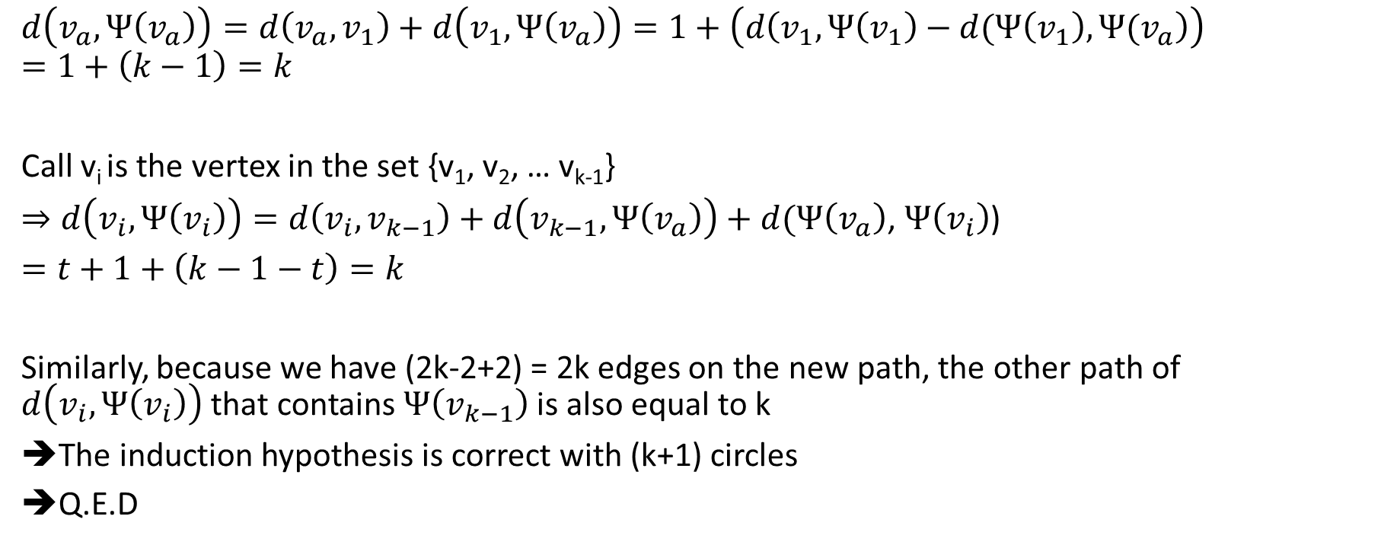
Lemma 1 - Proof
$$d\left(v_{a},Ψ\left(v_{a}\right)\right)=d\left(v_{a}, v_{1}\right)+d\left(v_{1},Ψ\left(v_{a}\right)\right)=1+\left(d\left(v_{1},Ψ\left(v_{1}\right)−d(Ψ\left(v_{1}\right),Ψ(v_{a}\right)\right)$$
$$=1+\left(k−1\right)=k$$
Call v_{i} is the vertex in the set {v₁, v₂, … v_{k-1}}
$⇒d\left(v_{i},Ψ\left(v_{i}\right)\right)=d\left(v_{i}, v_{k−1}\right)+d\left(v_{k−1},Ψ\left(v_{a}\right)\right)+d(Ψ\left(v_{a}\right)$, $Ψ\left(v_{i}\right)$)
$=t+1+\left(k−1−t\right)=k$
Similarly, because we have (2k-2+2) = 2k edges on the new path, the other path of $d\left(v_{i},Ψ\left(v_{i}\right)\right)$ that contains $Ψ\left(v_{k−1}\right)$ is also equal to k
The induction hypothesis is correct with (k+1) circles
Q.E.D

Slide 19
Lemma 2
G_{n special} can be seen in the form that has:
k triangles at the “outer cycle”
Another k triangles are made by the reflection and 1 polygon has k segments in the “middle”
The other polygons are quadrilaterals

Slide 20
Lemma 2 - Proof
Before going into proof, let’s see some special graphs G_{3 special} , G_{4 special} , G_{5 special}, G_{6 special} in the next slides

Slide 21
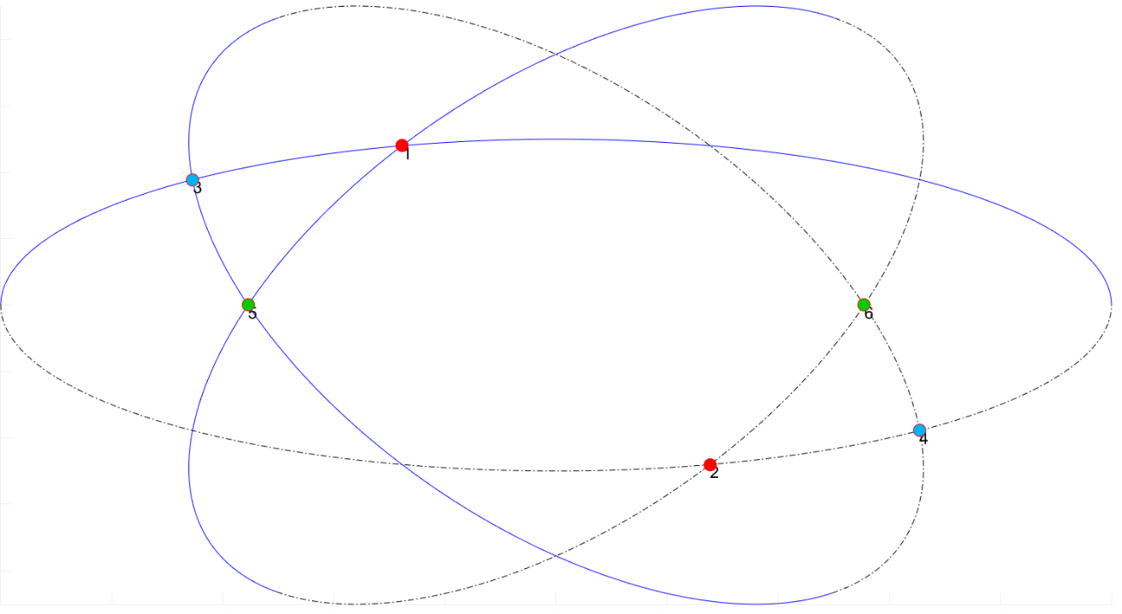
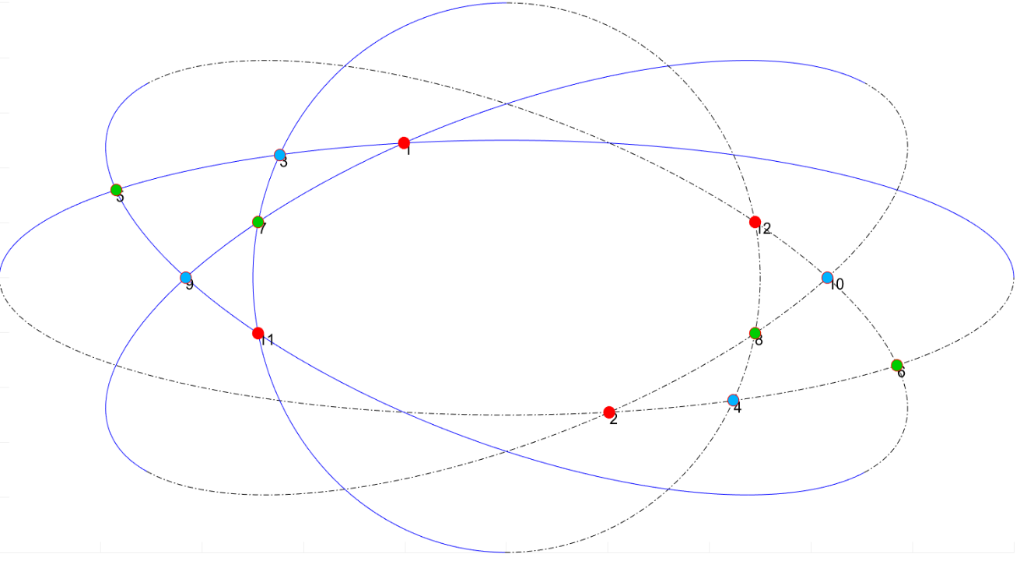
G_{3 special} , G_{4 special}
G_{3 special}
G_{4 special}

Slide 22
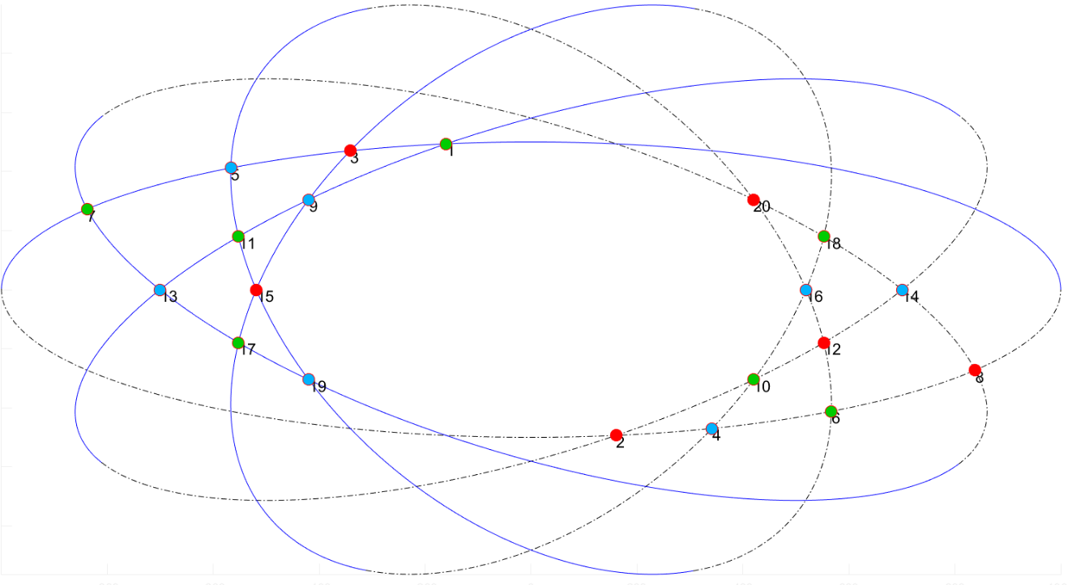
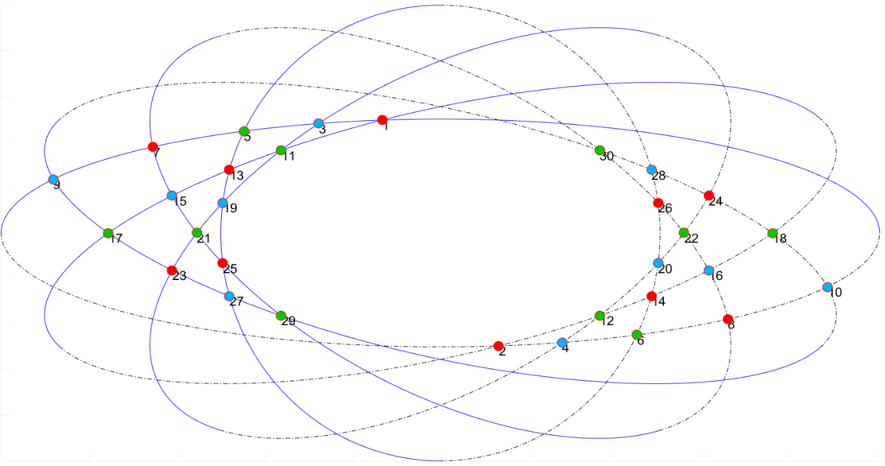
G_{5 special} , G_{6 special}
G_{5 special}
G_{6 special}

Slide 23
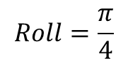
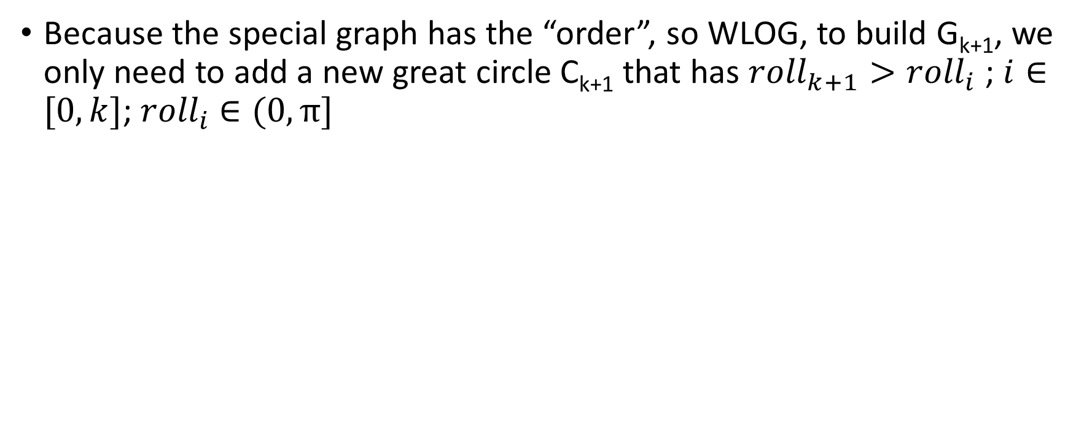
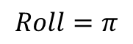
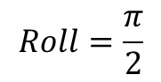
Lemma 2 - Proof
Because the special graph has the “order”, so WLOG, to build G_{k+1}, we only need to add a new great circle C_{k+1} that has ${roll}_{k+1}>{roll}_{i}$ ; $i∈[0, k]$; ${roll}_{i}$ $∈(0,π]$
$$Roll=\frac{π}{4}$$
$$Roll=\frac{π}{2}$$
$$Roll=π$$

Slide 24
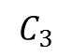
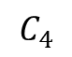
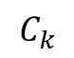
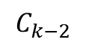
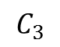
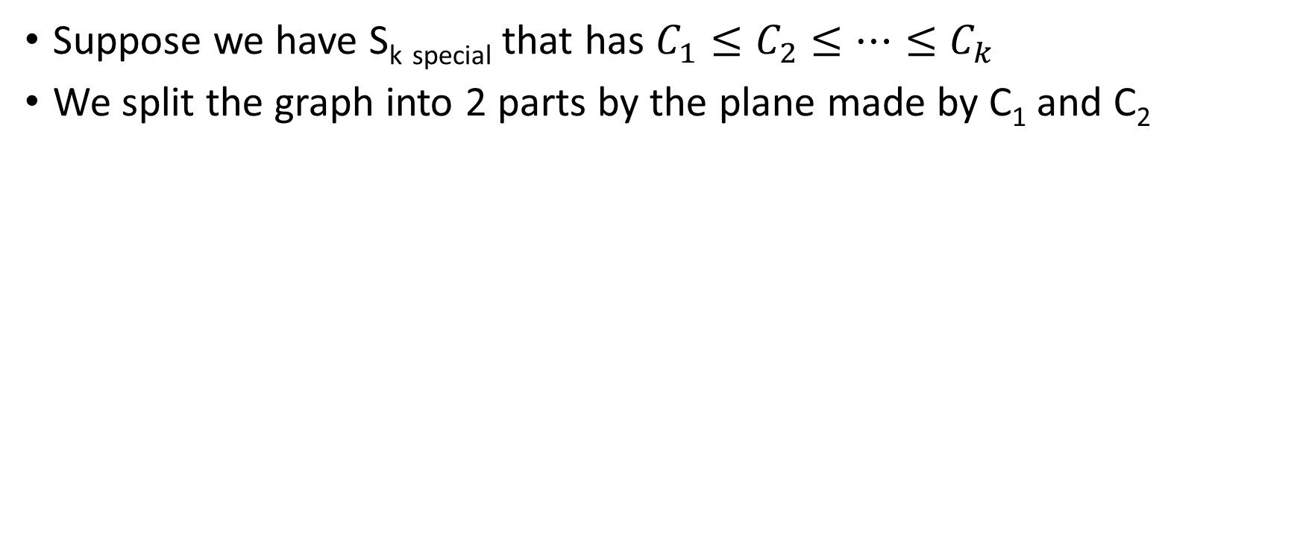
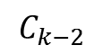
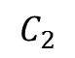
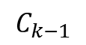
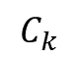
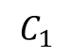
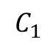
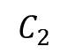
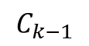
Lemma 2 - Proof
Suppose we have S_{k} _{special} that has $C_{1}≤C_{2}≤…≤C_{k}$
We split the graph into 2 parts by the plane made by C₁ and C₂
$$C_{1}$$
$$C_{2}$$
$$C_{3}$$
$$C_{k−2}$$
$$C_{k−2}$$
$$C_{k−1}$$
$$C_{1}$$
$$C_{2}$$
$$C_{3}$$
$$C_{k−2}$$
$$C_{k−2}$$
$$C_{k−1}$$
 | V | V | … | V | V | V
 | V | V | … | V | V
… | ... | … | …
 | V | V | V
 | V | V
 | V
 | V | V | … | V | V | V
 | V | V | … | ` | V
… | ... | … | …
 | V | V | V
 | V | V
 | V
$$C_{k}$$
$$C_{k}$$
$$C_{k}$$
$$C_{k}$$
$$C_{k−1}$$
$$C_{k−1}$$
$$C_{4}$$
$$C_{4}$$
$$C_{3}$$
$$C_{3}$$
$$C_{2}$$
$$C_{2}$$
$$C_{1}$$
$$C_{1}$$

Slide 25
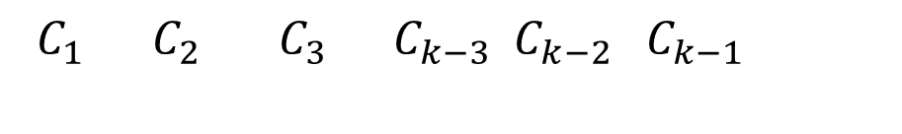
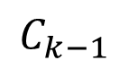
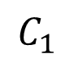
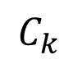
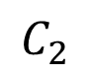
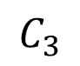
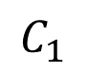
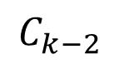
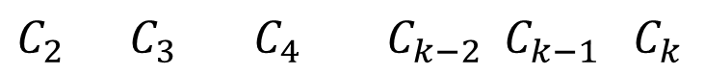
Lemma 2 - Proof
$C_{1}$ $C_{2}$ $C_{3} C_{k−3}$ $C_{k−2}$ $C_{k−1}$
 |  |  |  |  |  |  |  | V | V | … | V | V | V
 |  |  |  |  |  |  | V | V | V | … | V | V
 |  |  |  |  |  | V | V | V | V | … | V
 |  |  |  |  | … | … | … | … | … | …
 |  |  |  | … | V | V | V | V | V
 |  |  | V | … | V | V | V | V
 |  | V | V | … | V | V | V
$$C_{k}$$
$$C_{k−1}$$
k-polygon
$$C_{k−2}$$
$$C_{3}$$
k-polygon
$$C_{2}$$
$$C_{1}$$
$$C_{1}$$
$C_{2}$ $C_{3}$ $C_{4} C_{k−2}$ $C_{k−1}$ $C_{k}$

Slide 26
Lemma 2 - Proof
So pick 1 k-polygon and consider it as the bound of the new form
We have a place inside of graph for another k-polygon
The quadrilaterals will be filled
➔ The new form is isomorphic to the original 3D form of S_{n special}
(Lemma 2.2 will prove that the only way to get the new form of G_{k+1 special} is to add 1 great circle to the new form of G_{k special})

Slide 27
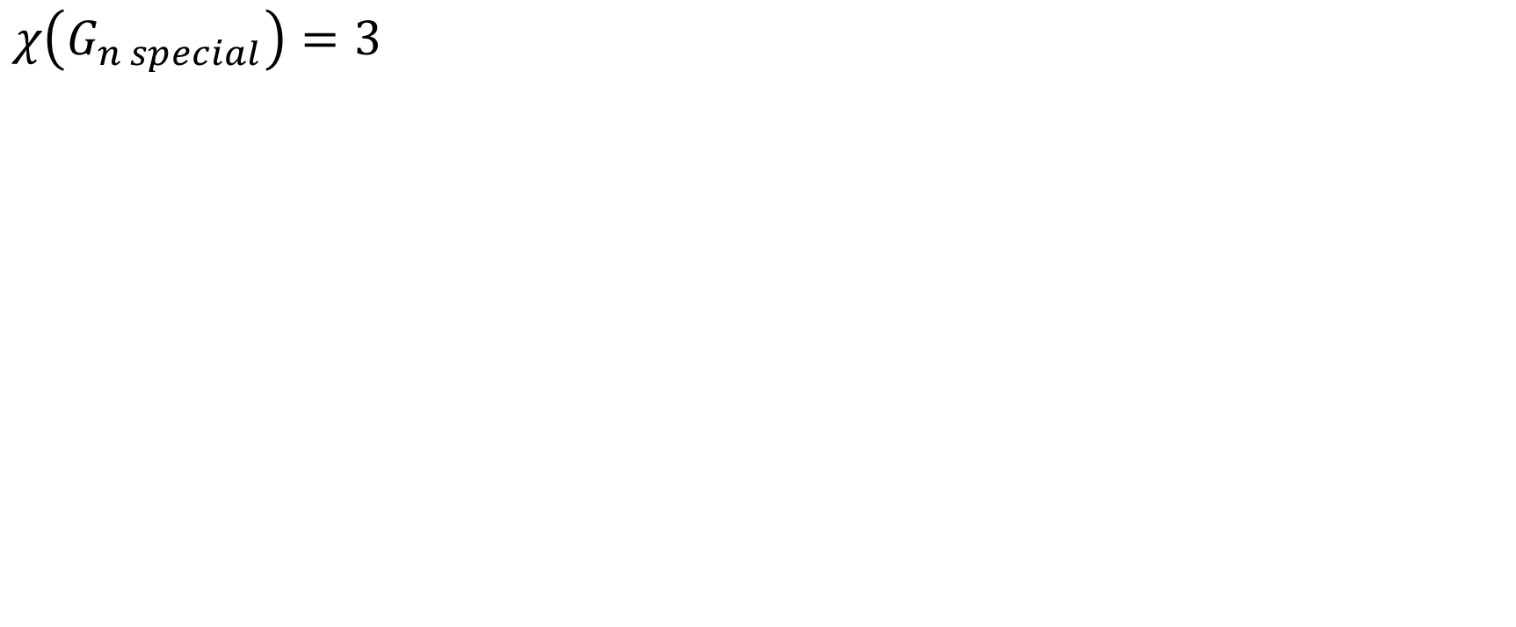
Theorem 1.
$$χ\left(G_{n special}\right)=3$$

Slide 28
Theorem 1 - Proof
I split the problem into 4 sub-problems that have:
3k great circles (3, 6, 9, 12, 15,….) (including (6k+3))
2k great circles (4, 6, 8, 10, 12,…) (including 6k, (6k+2), (6k+4))
(6k+1) great circles (7, 13, 19, 25,…)
(6k+5) great circles (5, 11, 17, 23,…)

Slide 29
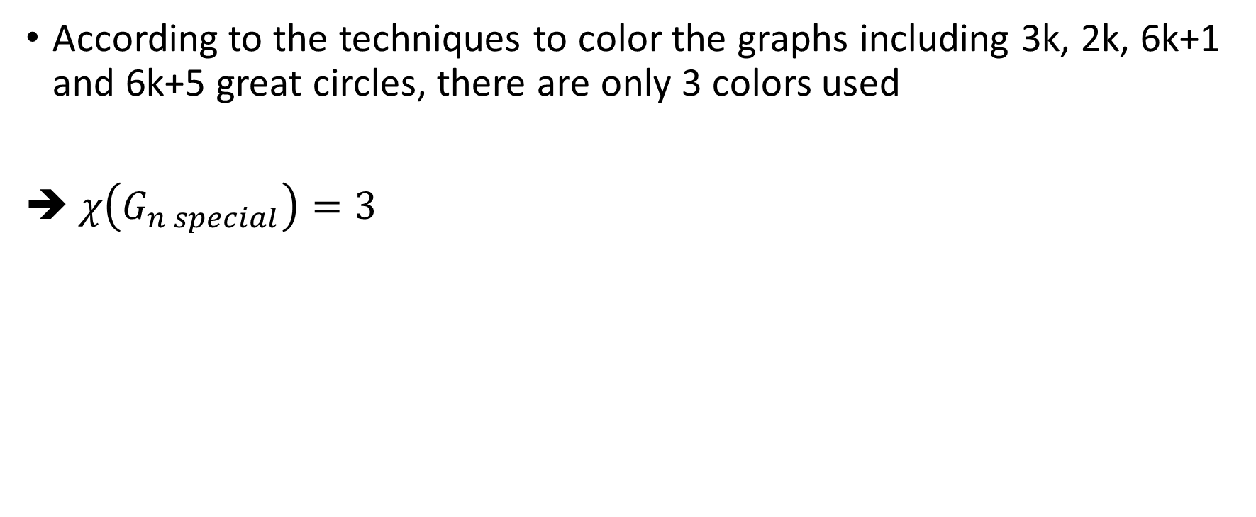
Chromatic number
According to the techniques to color the graphs including 3k, 2k, 6k+1 and 6k+5 great circles, there are only 3 colors used
➔ $χ\left(G_{n special}\right)=3$

Slide 30
Chromatic number
Some rules before coloring
Diagonal rule: The vertices on the same diagonal should have the same color (not a must because there are some places might have K₃ rule)
Proof: The vertices on the same diagonal are not connected together.
K₃ rule: 3 vertices that form a triangle must have 3 different colors

Slide 31

An annotation
Because I copied my old slides, there are some old symbols not updated in my images
That is the symbol $E_{τ_{i}}$ equals to $C_{i}$

Slide 32
Chromatic number of 3k circles

Slide 33

Chromatic number of 3k circles
Base cases: 3 great circles

Slide 34

Chromatic number of 3k circles
Base cases: 6 great circles

Slide 35

Chromatic number of 3k circles
Base cases: 9 great circles

Slide 36

Chromatic number of 3k circles
Base cases: 12 great circles

Slide 37

Chromatic number of 3k circles
According to the base cases with 3,6,9,12 great circles, the chromatic number is 3
➔Induction hypothesis: $χ\left(G(3K)\right)=3;$($k>0,k∈N)$ that has been correct with k=1,2,3,4 by spreading 3 colors from the bottom left to the top right of the equivalent graph.
➔Induction step: Prove that $χ\left(G(3(K+1))\right)=3$

Slide 38

Chromatic number of 3k circles
The graph G(3(k+1)) contains G(3k) which has been colored already, 3 rows and 3 columns that are not colored yet.

Slide 39

Chromatic number of 3k circles
The uncolored vertices in the diagonals of the graph G(3k) can be colored by the diagonal rule

Slide 40

Chromatic number of 3k circles
4 uncolored vertices on top can be colored by Red-Blue-Green respectively. We can see 3 nodes which link (3k+2) have 3 different colors. The link 3k and (3k+1) are still fine since the colors are generated in a specific order Red-Blue-Green. Everything is still fine

Slide 41

Chromatic number of 3k circles
12 uncolored vertices on the bottom left can be colored by Red-Blue-Green respectively spread from left to right respectively. Specially, 3 vertices whose link (2) have 3 different colors. The vertices which link 3,4,5,6,7 do not conflict others on top

Slide 42

Chromatic number of 3k circles
➔$χ\left(G(3(K+1))\right)=3$
➔ The induction hypothesis is correct
➔ $χ\left(G(3k\right))=3$ $;$($k>0,k∈N)$

Slide 43
Chromatic number of 2k circles

Slide 44


Chromatic number of 2k circles
With the graph 2k, I tried the same way to color the graph but it didn’t work out
8 great circles
10 great circles

Slide 45


Chromatic number of 2k circles
I tried to color it into a different way is to spread 2 colors Blue-Green from the bottom left to the top right of the equivalent graph and then put the color Red into the appropriate vertices.
6 great circles
8 great circles

Slide 46

Chromatic number of 2k circles
Base cases: 10 great circles

Slide 47

Chromatic number of 2k circles
According to the base cases with 4,8,10 great circles, the chromatic number is 3
➔Induction hypothesis: $χ\left(G(2K)\right)=3;$($k>1,k∈N)$ that has been correct with k=2,4,5 by spreading 2 colors Blue-Green from the bottom left to the top right of the equivalent graph and then putting the color Red into the appropriate vertices.
➔Induction step: Prove that $χ\left(G(2(K+1))\right)=3$

Slide 48

Chromatic number of 2k circles
The graph G(2(k+1)) contains G(2k) which has been colored already, …..

Slide 49

Chromatic number of 2k circles
The vertices on the right edge of G(2k) can use 1 color Green since currently they don’t have the K₃ rule

Slide 50

Chromatic number of 2k circles
The vertices on the right and top can be colored by spreading Green-Blue and placing Red as the figure to satisfy the K₃ rule on the right edge

Slide 51

Chromatic number of 2k circles
Continue to color others by the same way. The vertices which link (3,4,5,…2k) on top don’t conflict those on bottom. All the K₃ are also satisfied

Slide 52

Chromatic number of 2k circles
➔$χ\left(G(2(K+1))\right)=3$
➔ The induction hypothesis is correct
➔ $χ\left(G(2k\right))=3$ $;$($k>1,k∈N)$

Slide 53
Chromatic number of (6k+1) circles

Slide 54



Chromatic number of (6k+1) circles
This type of graph doesn’t suit 2 previous coloring ways because:
3k: There is always a K₃ (2) that contains 2 vertices have the same color because $\left(6k+1\right)≡1\left(mod 3\right)$
2k: $\left(6k+1\right)≡1\left(mod 2\right)$, so K₃ (contains link 2) always has 2 vertices have the same color
Color the graph by the way used on 3k graphs
Color the graph by the way used on 2k graphs

Slide 55

Chromatic number of (6k+1) circles
By modifying the technique of 3k graphs a little bit, I can color the graph with 7 great circles. We can see the difference in between 2 black slashes

Slide 56

Chromatic number of (6k+1) circles
Greedily continue to color the graph with 13 great circles, we can see that outside of the slashes, the colors are similar to the 1st technique used for 3k graphs

Slide 57

Chromatic number of (6k+1) circles
Another base case with 19 great circles

Slide 58

Chromatic number of (6k+1) circles
With k>2, by spreading RED-BLUE-GREEN respectively on the additional diagonals, I can color all this type of graph based on the case k=2
The vertex on the top right is always left because
step $6k≡0\left(mod3\right)$
The other additional vertices use spreading
technique which doesn’t create conflicts on
the links at edges
Similar to the coloring way of 3k graphs,
all additional K₃ are also satisfied
This vertex is always red

Slide 59
Chromatic number of (6k+5) circles

Slide 60

Chromatic number of (6k+5) circles
Base cases: 5 great circles

Slide 61

Chromatic number of (6k+5) circles
Base cases: 11 great circles

Slide 62

Chromatic number of (6k+5) circles
Base cases: 17 great circles

Slide 63
Chromatic number of (6k+5) circles
This type of graph is similar to (6k+1) graph. With cases k>1, by spreading RED-BLUE-GREEN respectively on the diagonals, I can color all this type of graph based on the case k=1

Slide 64
Generated 1000 great circles of 5, 6, 7, 8 great circles

Slide 65
Non-isomorphic graphs
I generated 1000 graphs for each 6,7,8 great circles.
6 great circles: have 4 non-isomorphic graphs.
7 great circles: have 11 non-isomorphic graphs.
8 great circles: have 114 non-isomorphic graphs.
These graphs might be helpful for us to see how they have been changed.

Slide 66
Non-isomorphic graphs made by 6 great circles

Slide 67

1
7
11
15
21
9
17
23
29
6
20
27
25 ₁₃
3
4
10 16
5
24
2
8
14
12
18
22
19
30
26
28

Slide 68

3
8
22
5
19
26
24
28 15
1
18
10
12
14 29
20 7
4
9
11
2
6 21
23
25
30
16
27
13
17

Slide 69

1
7
11
15
21
3
9
24 30
18
₆ 20 26 ₁₄
4 16
2
12 8
27
28
13
17
10
5
22
29
23
25

Slide 70

1
9
11
17
3
29 21
7
23
15
₅ 19 27 ₁₄
4 18
2
12 10
25
26
13
16
8
6
22 30
24
28

Slide 71
Non-isomorphic graphs made by 7 great circles

Slide 72

5
3
15
24
8
13
17
1
31
25
9
37
29
35
19
41
27
22
11
39
33
34
21
7
23
20
12
18
6
4
16
2
36
32
14
10
26
28
30
38
40
42

Slide 73

5
31
3
33
9
25
27
7
38
23
18
14
16
12
42
22
20
40
30
35
2
₃₂ 24
26
36
1
10
15
34
6
29
4
11
28
8
13
37
39
17
41
19
21

Slide 74

1
7
15
17
5
10
38
33
20
26
24
41
4
32 29
21
14
12
₃₆ 40 27
6
16
18 ¹⁹
8 ₉
37
13
22
2
28
3
11
42
34
25
30
23
31
39
35

Slide 75

1
3
15
13
24
5
8
32 ₂₆
40
21
₃₆ 30
18
10 42 34 28 ³⁷ ₁₉
11
12 17
20
6 14
2
16 4
22
7
9
23
38
39
25
31
41
29
35
27
33

Slide 76

1
9
17
19
37
8
11
39
34
16
35
31
42
3
²³ 25 28
22
6
29
5 ₇
18
14
2
20
30
13
15
10
12
4
21
38
33
40
36
24
41
32
27
26

Slide 77

5
9
33
3
23
42
30
28
11
31
40
26
20
1
36
14
18
38
21
7
16
24
10
8
15
22
6
32
35
12
4
34
2
29
41
39
27
37
19
25
13
17

Slide 78

1
11
17
21
29
7
4
25
39
28
10
³⁸ 42
23 15
32 ³⁶
33
13
20
14
6
⁸ 22
19
16
18
2
12
27
24
3
5
26 30
9
34
40
41
37
35

Slide 79

3
1
13
28
11
29
17
7
20
41
39
9 25
37
⁵ 31 33 23
8 27
35
21
16
22
15
18
4
14 2
19
36
40
30
12
42
24
6
26
10
38
34

Slide 80

5
35
1
11
22
15
42
9
20
24
28
₁₈ 40
¹⁴ 30
8
33
26
38
4
31
32
34 16
2
12
⁶ 36
3
23
10
37
7
21
27
41
19
39
25
17
29
13

Slide 81

13
19
27
17
25
9
7
29
11
37
5
15
40
36
34
21
4
32
42
1
23
24
26
20
22
2
14
3
16
18
28
30
6
8
10
12
38
41
33
39
31
35

Slide 82

1
19
12
9
22
41
7
39 28
26
35 23 32 34
29 38
14
17
4
5
16
3
11 20
18
15
2
6
13
21 10
8
37
42
30
33
27
40
36
25
31
24

